Slide 1

project

Slide 2
SGBD/DBMS- Database management system
A database management system (DBMS) is a software package designed to define, manipulate, retrieve and manage data in a database.
A DBMS generally manipulates the data itself, the data format, field names, record structure and file structure.
It also defines rules to validate and manipulate this data.
ex: MySQL, PostgreSQL, Microsoft Access, SQL Server, FileMaker, Oracle, RDBMS, dBASE, Clipper, and FoxPro

Slide 3
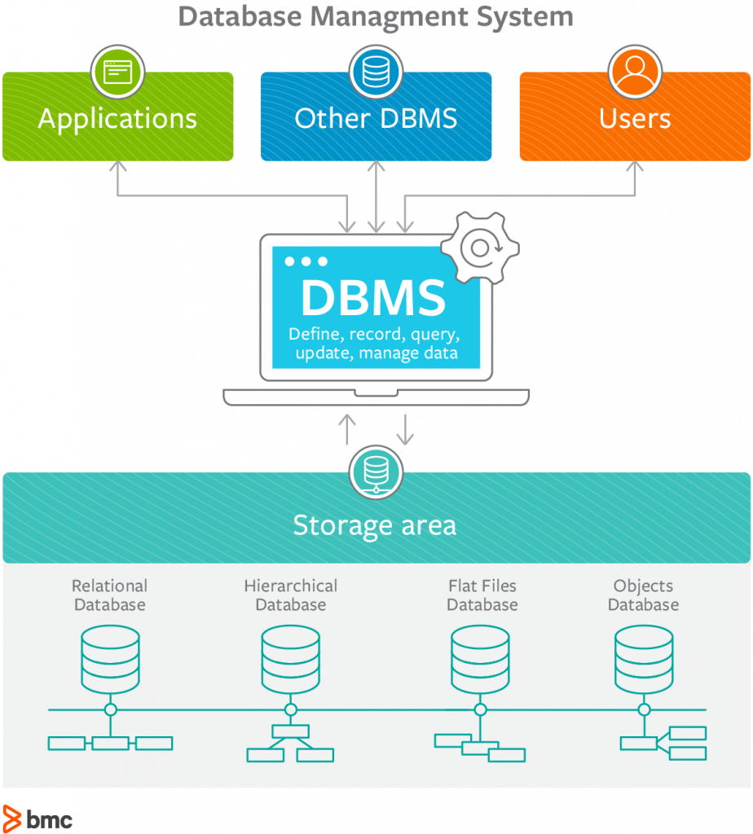

Slide 4
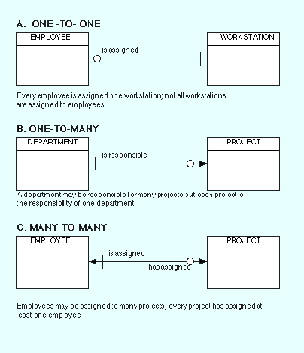
Relational Model
Relational Model represents how data is stored in Relational Databases.
ex:A relational database stores data in the form of relations (tables). Consider a relation EMPLOYEE with attributes EMPLOYEE_ID, NAME, ADDRESS, PHONE and AGE.
3 Types of relation between tables

Slide 5
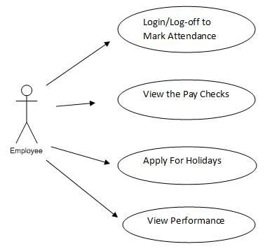
UML Diagram
A UML diagram is a diagram based on the UML (Unified Modeling Language) with the purpose of visually representing a system along with its main actors, roles, actions, artifacts or classes, in order to better understand, alter, maintain, or document information about the system.
Use Case Diagram(behavior diagram in UML):

Slide 6
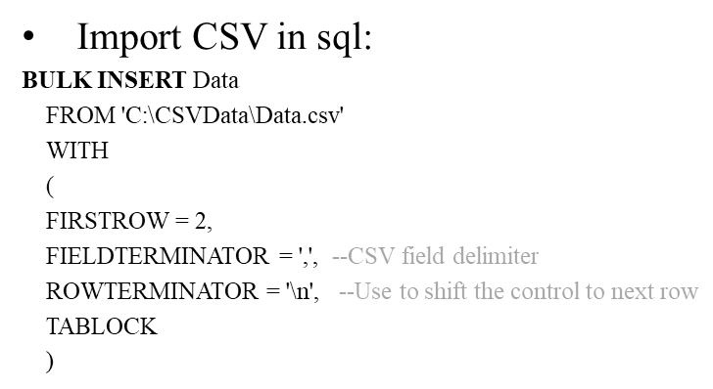
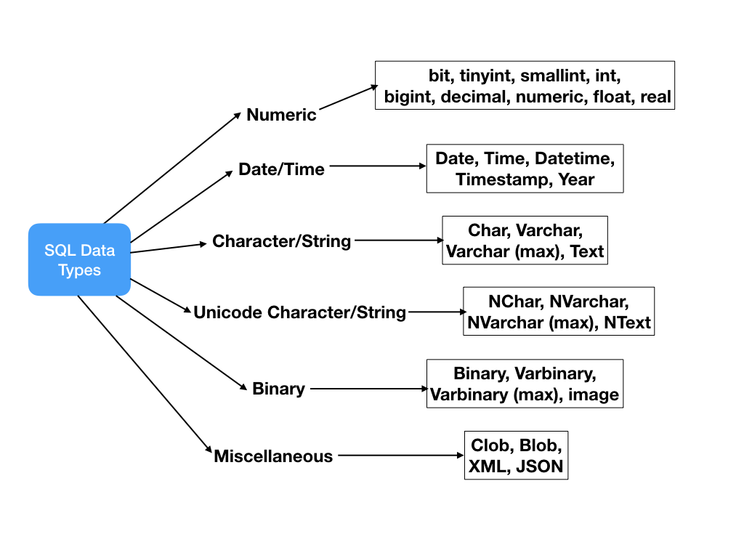
Syntax:
Create a new table in a database:
CREATE TABLE table_name ( column1 datatype, column2 datatype, column3 datatype, ....);
Data-Types in SQL:

Slide 7
Primary and Secondary Keys
A primary key is a field in a table which uniquely identifies each row/record in a database table. Primary keys must contain unique values. A primary key column cannot have NULL values.
Secondary Key is the key that has not been selected to be the primary key. However, it is considered a candidate key for the primary key.
Ex: In Student table Student_id=>Primary key
Student_email=>Secondary key
Conceptual Model
The main aim of this model is to establish the entities, their attributes, and their relationships. In this Data modeling level, there is hardly any detail available of the actual Database structure. It offers Organisation-wide coverage of the business concepts.
The 3 basic tenants of Data Model are
Entity: A real-world thing
Attribute: Characteristics or properties of an entity
Relationship: Dependency or association between two entities

Slide 8
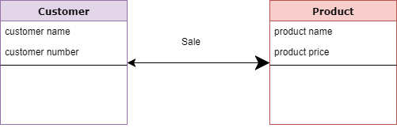
Examples of Conceptual Model
Ex1:
Customer and Product are two entities. Customer number and name are attributes of the Customer entity
Product name and price are attributes of product entity
Sale is the relationship between the customer and product
Ex2:
Students and Course are two entities. Student Id and name are attributes of the Student entity
Course name and Course number are attributes of course entity
Enroll is the relationship between the student and course
Ex2:
Employee and Department are two entities. Employee Id and name are attributes of the Employee entity
Department name and id are attributes of Department entity
Manages is the relationship between the employee and department

